Slide 1

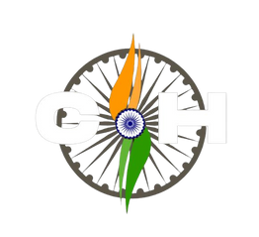

























Project Title:
“Global Organ Matching with Privacy-Preserving AI”
Team Name:
UN- SDG initiative
Team Kaizen
Team Members:
Mr.Yash kapse
Mr.Arpit rangari
Miss.Dhanshree Bhorkar
Miss.Kanchan gaikwad
Chapter 3
Domain:
SDG3: Good Health & Well-Being - emergency response and healthcare accessibility
Central India Hackathon 3.0 • SDG 3 & SDG 9

Slide 2
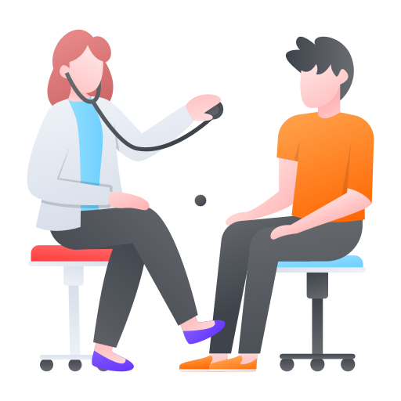


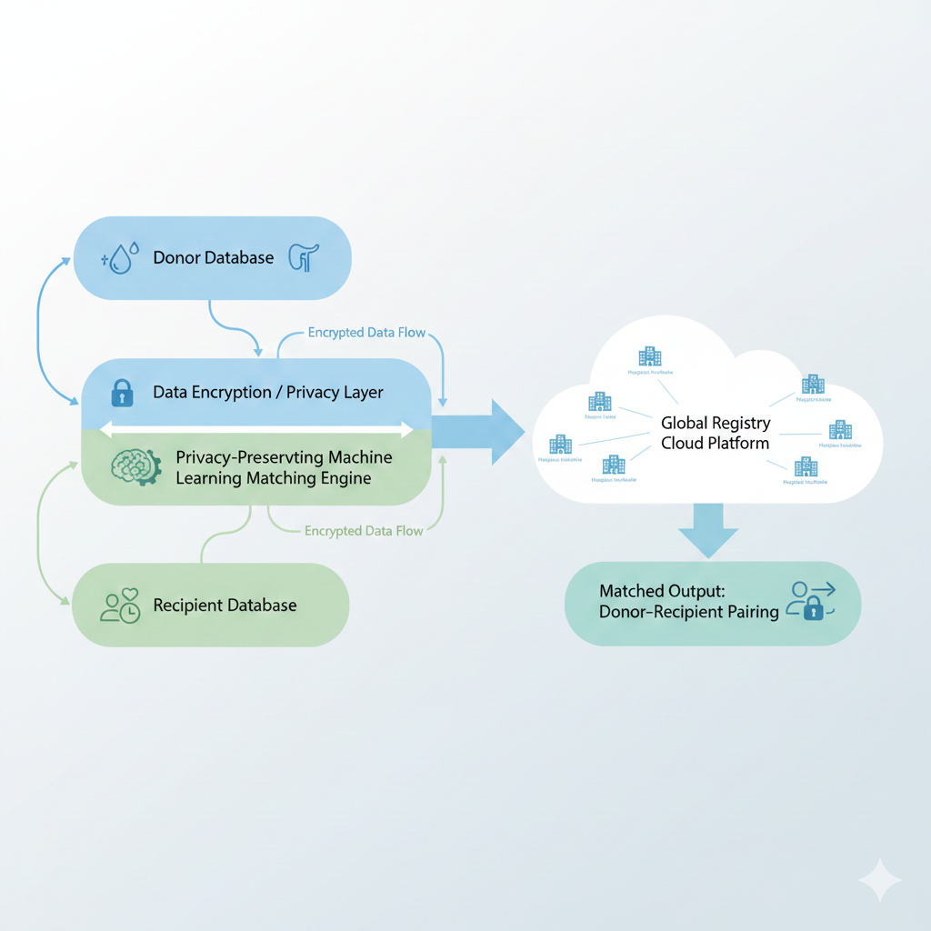
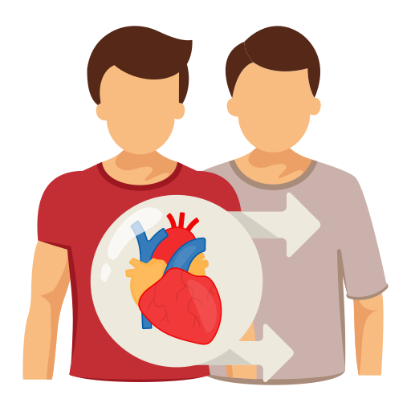
Problem Statement
Problem statement :
Whom does it affect?
Why is it important in context of SDG 3?
Create a platform matching organ donors with recipients via privacy-preserving ML matching, global registry startup-There is no secure global system to match organ donors with patients. Our platform uses privacy-preserving machine learning to safely match donors and recipients without revealing personal data, helping save lives faster and securely.
Patients & Families
Doctor and transplant coordinator
Hospitals
Organ donors and Families
Helps save lives by faster organ matching
Reduces waiting time for critical patients
Improves access to quality healthcare globally
Ensures safe and ethical use of medical data
Strengthens efficient healthcare systems
Current challenges and gap :
No centralized global organ registry
Fragmented data across hospitals and countries
Privacy and security risks in sharing medical data
Slow and manual matching processes
Lack of transparency and coordination
Central India Hackathon 3.0 • SDG 3 & SDG 9

Slide 3
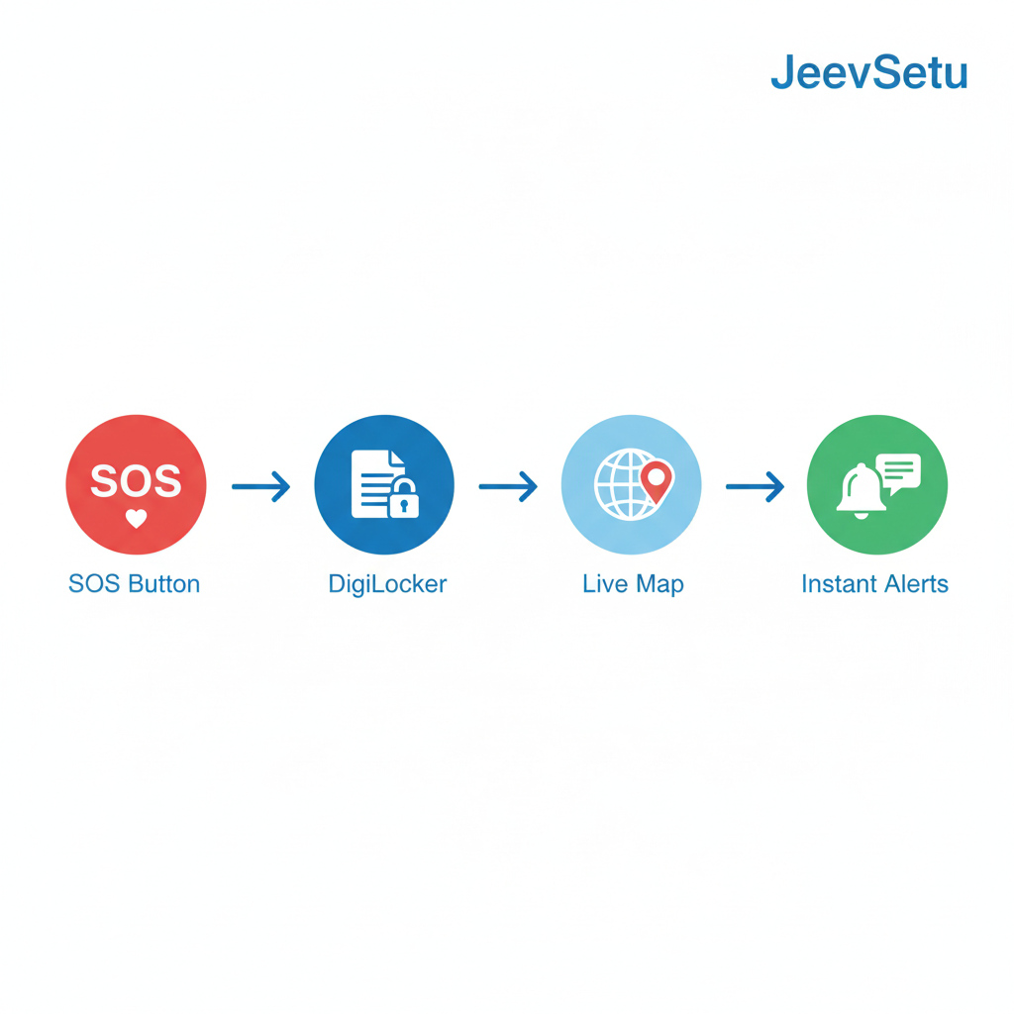
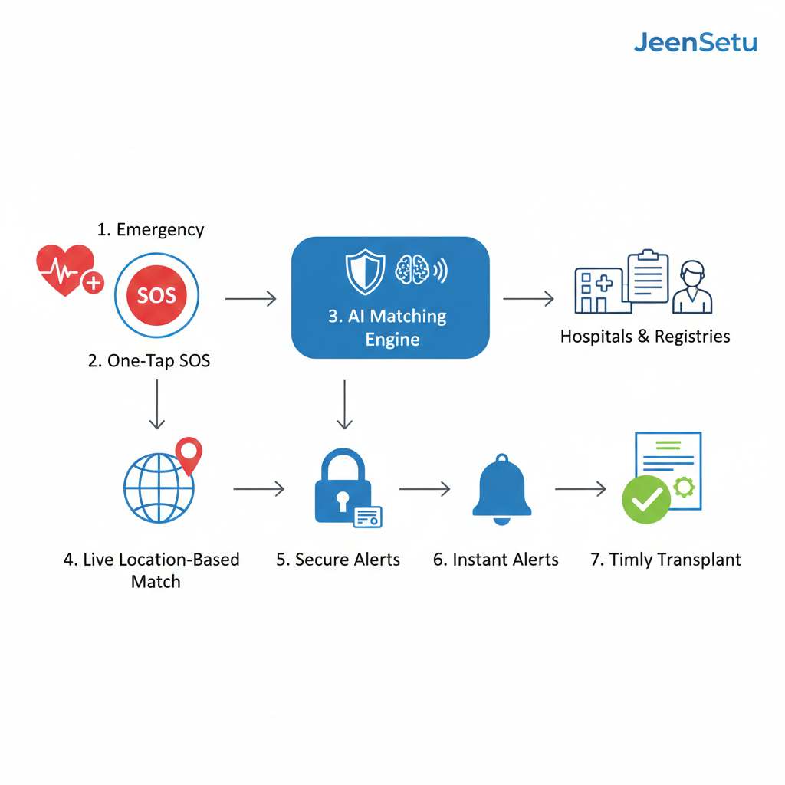
Proposed Solution
Clear explanation of the idea:
One-tap SOS for instant emergency action
DigiLocker verification for trust and authenticity
Live map–based real-time matching
Instant alerts to nearby donors and hospitals
JeevSetu is a secure global platform that connects organ donors and patients during critical emergencies. Users and hospitals are verified using DigiLocker to ensure trust. The system uses privacy-preserving machine learning to find the best donor match without exposing personal data. With a one-tap SOS button and live map, JeenSetu quickly connects patients to the nearest compatible donors or hospitals, helping save lives faster and safely.
Why is it innovative?
Value proposition
How does it solve the problem?
One tap emergency SOS for instant organ matching.
Automatically matches:
medical compatibility
live location
Shows nearby donors on a secure live map.
Send instant alerts to hospitals and eligible donors.
Verified trust using DigiLocker integration.
Instant emergency organ matching
Privacy-first ML compatibility
Verified donors and hospitals
One-tap SOS response
Secure global registry
Central India Hackathon 3.0 • SDG 3 & SDG 9

Slide 4


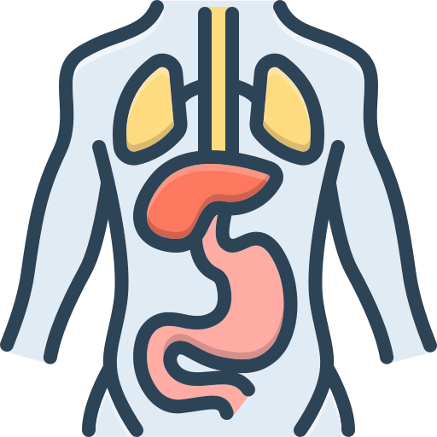

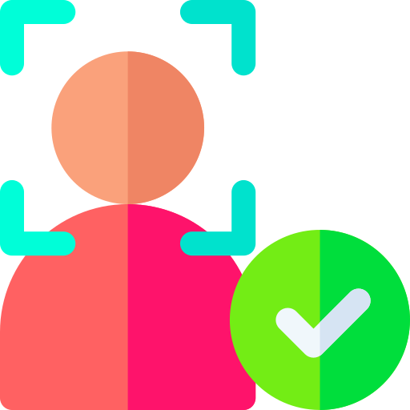







Implementation Overview
Start
Emergency Organ Request Intake
User Authentication & Trust Layer
Real-Time Organ Availability
Matching Engine
Map-Based Discovery
MERN, Firebase, Expo
Fast API, Pandas, NumPy
Mapbox, Google Maps Api
Firebase , Twilio OTP, MongoDB, JWT
Hospital APIs, Python + Requests
End : Final Report Generator
Admin Panel & Analytics
Impact Dashboard
Donar Notification Engine
Reportlab, Pandas
Streamlit, Express.js, MongoDB, Auth0
Matplotlib, Plotly, Streamlit
Firebase Cloud Messaging, Twilio,
Central India Hackathon 3.0 • SDG 3 & SDG 9

Slide 5





Impact & Feasibility
Expected impact
Faster Emergency Response:
Blood search time reduces from hours to minutes
Timely blood availability during critical medical emergencies
Through DigiLocker verification trust increases certainly
Live saved:
Innovative:
Feasibility
Cost-Effective:
Scalable:
Uses digital verification and automated matching to reduce manual and operational costs.
Cloud-based architecture allows easy expansion across hospitals, cities, and countries.
Combines privacy-preserving ML with real-time location tracking for secure organ matching
Nearby Donor Visibility:
Verified network:
Live tracking helps hospitals quickly find the nearest compatible donors and facilities.
Social , technical, economic relevance
Enables rapid access to in life threatening situations
Makes blood availability visible and reachable for all
Strengthens critical healthcare through technology
How it supports SDG goals
Social: Saves lives by giving fast, trusted help during medical emergencies.
Technical: Uses DigiLocker verification, live maps, and smart matching to connect the right people instantly.
Economic: Reduces emergency costs and wastage by using a low-cost, efficient digital system
Emergency Care Enhancement
Healthcare accessibility
Digital health
infrastructure:
Central India Hackathon 3.0 • SDG 3 & SDG 9

Slide 6

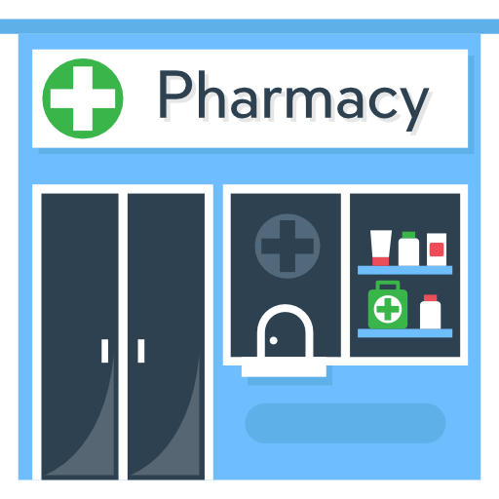





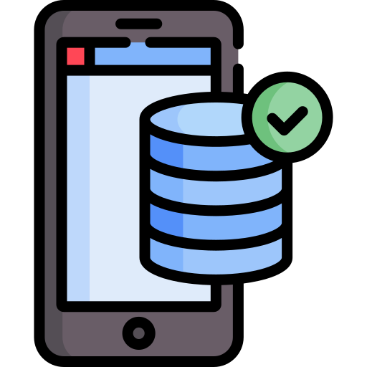

Revenue Model & Future Scope
How will you generate revenue in your terms
Future improvements
Hospitals & Blood Subscription
Government, NGO & CRS Funding
Data insights
Pharmacy & Medical Store Listings
Paid visibility for pharmacies showing:
Monthly subscription for:
Access to verified donors
Live blood demand analytics
Emergency SOS alerts
Emergency medicine availability
Night-time & nearby services
Funding support for:
Blood donation camps
Public health emergencies
Rural healthcare initiatives
Sell non-personal, anonymized analytics for:
Health planning
Emergency preparedness
Blood demand forecasting
Emergency Integration
Inclusive Access
AI Demand Prediction
Predict blood shortages in advance
🚑
Ambulance & emergency service linking
🌐
Multi-language & offline SOS for rural areas
Roadmap (next 6 months or year)
Foundation
Trust & Integration
Expansion
Pilot & Scale
SOS & Live Map
Backend & database
Donor, patient, hospital roles
Medicine availability
Pharmacy onboarding
Social media emergency scraping
DigiLocker verification
Lab & blood group validation
Hospital & blood bank dashboard
City-level pilot
Blood testing camps
Feedback & optimization
Government / NGO readiness
Central India Hackathon 3.0 • SDG 3 & SDG 9

Slide 7
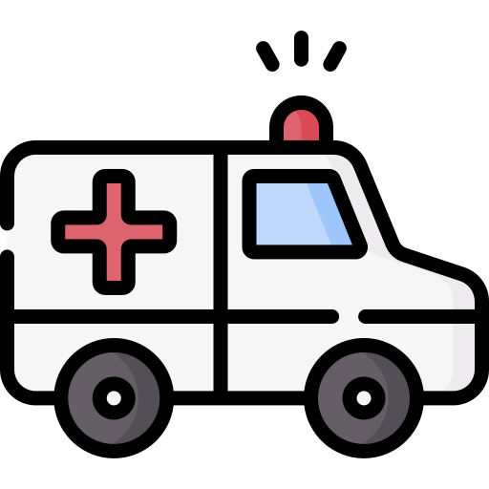


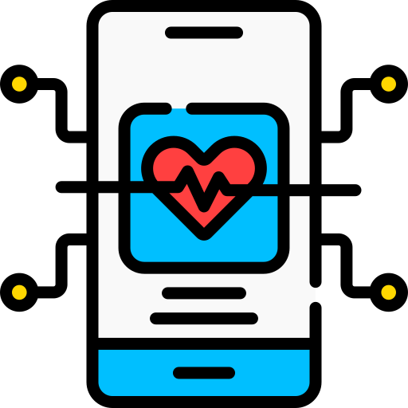
Conclusion
The solution addresses a real and critical problem of delayed blood and medicine access during emergencies.
Live maps, SOS alerts, and data integration enable faster, smarter emergency response.
DigiLocker-based verification ensures trust, accuracy, and reliability of donor information.
The platform is practical, scalable, and capable of saving lives in real-world scenarios.
Central India Hackathon 3.0 • SDG 3 & SDG 9

